Slide 1


Introduction to Self-Service Password Reset
Self-service password reset is a powerful tool that empowers employees to securely manage their own passwords, reducing the burden on IT support teams and improving overall productivity. By allowing users to reset their passwords independently, organizations can streamline their password management processes, enhance security, and provide a more seamless user experience.

Slide 2
Benefits of Self-Service Password Reset
Improved Efficiency
Enhanced Security
Improved User Experience
Self-service password reset reduces the number of password-related support requests, allowing IT teams to focus on more strategic initiatives. This helps organizations save time and resources, improving overall operational efficiency.
By putting password management in the hands of users, self-service password reset can help mitigate the risk of unauthorized access and password-related security breaches. Users can reset their passwords securely, without relying on IT support.
Self-service password reset empowers users to regain control over their accounts, leading to increased satisfaction and productivity. Users can quickly and easily reset their passwords, reducing frustration and downtime.

Slide 3

Enabling Self-Service Password Reset
1
Assess Requirements
Evaluate your organization's current password management practices, user demographics, and IT support capabilities to determine the specific requirements for your self-service password reset implementation.
2
Choose a Solution
Select a self-service password reset solution that aligns with your organization's needs, security requirements, and integration with your existing identity and access management infrastructure.
3
Implement and Test
Carefully plan and execute the implementation of your self-service password reset solution, ensuring a seamless integration with your IT systems and thorough testing before rolling it out to users.

Slide 4
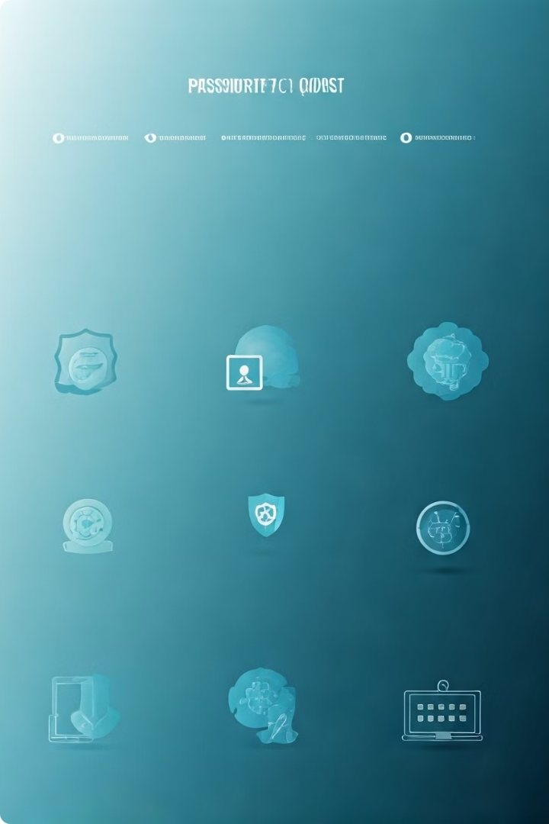
Configuring Password Reset Policies
1
Password Complexity Requirements
Define the password complexity requirements, such as minimum length, character composition, and uniqueness, to ensure a high level of security and compliance with industry standards.
2
Password Expiration Policies
Establish policies for password expiration, requiring users to regularly update their passwords to enhance security and reduce the risk of compromised credentials.
3
Multi-Factor Authentication
Implement multi-factor authentication (MFA) as an additional layer of security, ensuring that users can only reset their passwords after successfully verifying their identity through multiple authentication factors.
4
Lockout and Retry Policies
Configure lockout and retry policies to prevent brute-force attacks and limit the number of failed password reset attempts, further protecting the integrity of your password reset system.

Slide 5





Integrating Self-Service Password Reset with Identity Providers
Identity Integration
Seamlessly integrate your self-service password reset solution with your organization's identity management system, ensuring a unified and consistent user experience across all applications and services.
Cloud Integration
For organizations leveraging cloud-based identity providers, ensure a smooth integration between your self-service password reset solution and the identity services hosted in the cloud.
Directory Synchronization
Implement robust directory synchronization mechanisms to ensure that user accounts and password reset policies are consistently applied across all connected systems and applications.
Security Integration
Integrate your self-service password reset solution with your organization's security protocols and access controls to maintain a high level of security and compliance.

Slide 6

Customizing the Password Reset Experience
Branded User Interface
Personalized Notifications
Customize the user interface of your self-service password reset solution to align with your organization's branding, creating a seamless and consistent experience for users.
Provide personalized notifications and guidance to users throughout the password reset process, ensuring they feel supported and informed at every step.
Multilingual Support
Self-Help Resources
Offer multilingual support to accommodate users from diverse backgrounds and ensure inclusive access to the self-service password reset functionality.
Develop a comprehensive knowledge base or FAQ section to empower users with self-help resources, reducing the need for IT support and enhancing the overall user experience.

Slide 7
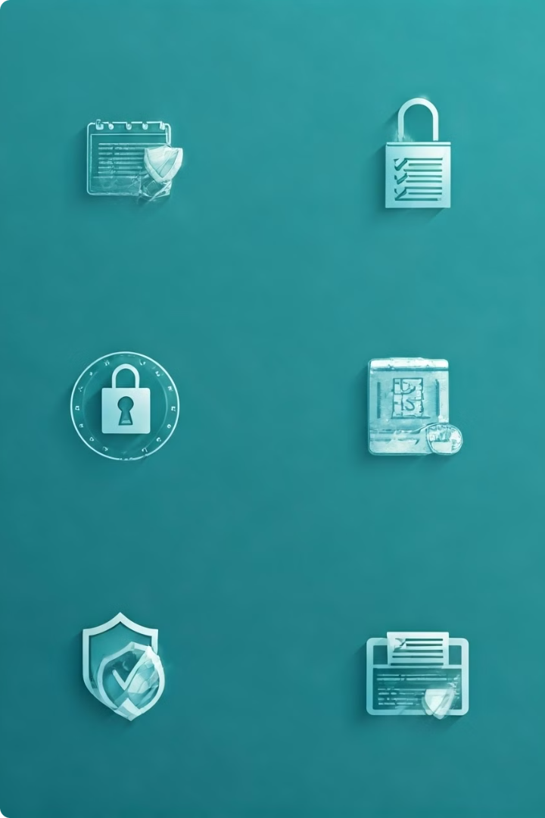



Securing the Password Reset Process
Identity Verification
Implement robust identity verification mechanisms, such as multi-factor authentication or knowledge-based challenges, to ensure that only authorized users can reset their passwords.
Audit Logging
Maintain comprehensive audit logs of all password reset activities, including the user's identity, timestamp, and any suspicious or failed attempts, to monitor and investigate potential security incidents.
Secure Communication
Ensure that all communication channels involved in the password reset process, such as email or SMS notifications, are secured through encryption and other security measures to prevent unauthorized access.

Slide 8
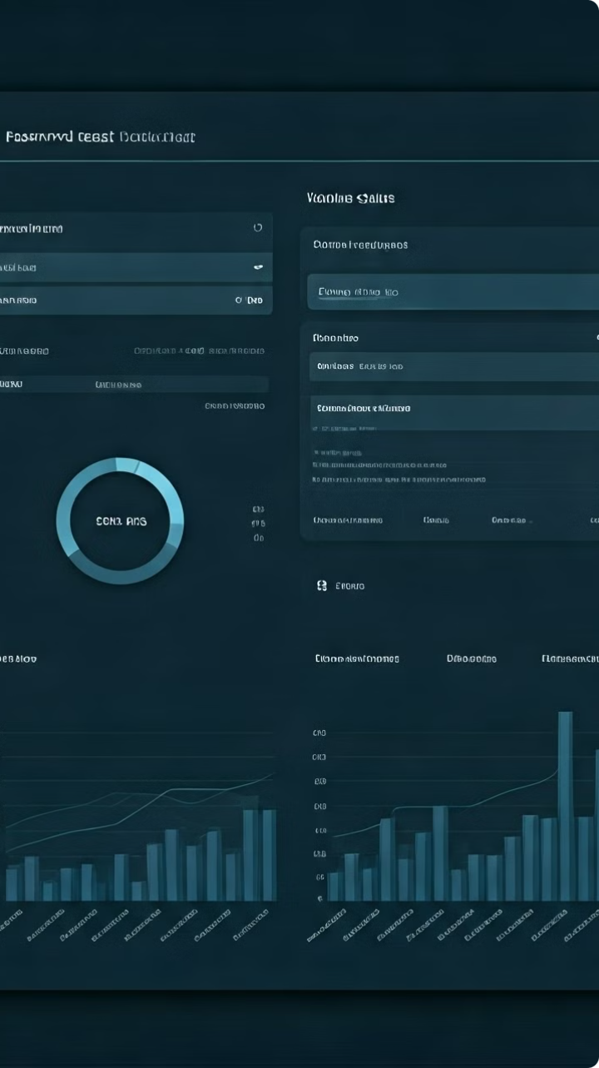
Monitoring and Auditing Password Reset Activities
Metric
Description
Importance
Password Reset Requests
Track the number of password reset requests, both successful and failed, to identify trends and potential security issues.
Helps identify any unusual spike in password reset activities that could indicate a security breach or credential compromise.
Self-Service Adoption Rate
Monitor the percentage of users who are actively using the self-service password reset functionality, rather than relying on IT support.
Indicates the effectiveness of the self-service password reset implementation and user acceptance, which can guide future improvements.
User Satisfaction
Gather user feedback and ratings to understand their satisfaction with the self-service password reset experience.
Helps identify areas for improvement and ensure the solution is meeting user needs and expectations.
Security Incidents
Analyze any security incidents or suspicious activities related to password resets, such as unauthorized attempts or successful breaches.
Enables proactive risk mitigation and continuous improvement of the password reset security measures.

Slide 9




Troubleshooting Common Issues
Authentication Failures
Address any issues with user authentication, such as failed multi-factor authentication or incorrect answers to security questions, to ensure a seamless password reset process.
Notification Delivery
Investigate and resolve any problems with the delivery of password reset notifications, such as email or SMS messages, to ensure users receive the necessary information to complete the reset process.
Directory Synchronization
Troubleshoot any issues with the synchronization of user accounts and password reset policies between your self-service solution and the connected identity management systems.

Slide 10

Conclusion and Next Steps
1
Continuous Improvement
Regularly review and refine your self-service password reset solution, incorporating user feedback, security best practices, and emerging trends to ensure ongoing optimization and enhanced user experience.
2
Expand Functionality
Consider expanding the self-service password reset functionality to include additional capabilities, such as self-service account unlocking or profile management, to further empower users and streamline IT support.
3
Evaluate Emerging Technologies
Stay informed about the latest advancements in password management and identity and access management technologies, and explore opportunities to incorporate innovative solutions that can further enhance the security and efficiency of your self-service password reset system.

